Slide 1
Security Hardening – Case Study - WLAN
WLAN Controller STIG
DISA, Release 12
28 Oct, 2016

Slide 2
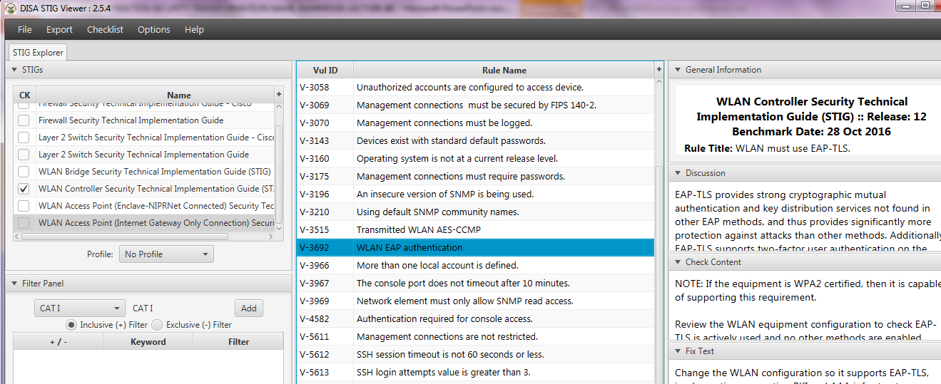
Security Hardening – Case Study - WLAN
STIGVIEWER WINDOW

Slide 3
Security Hardening – Case Study - WLAN
General Information:
Rule Title : WLAN must use EAP-TLS

Slide 4
Security Hardening – Case Study - WLAN
General Information:
Vuln ID: V-3692
STIG ID: WIR0115-01
Severity: CAT II

Slide 5
Security Hardening – Case Study - WLAN
Discussion:
EAP-TLS provides strong cryptographic mutual authentication and key distribution services not found in other EAP methods, and thus provides significantly more protection against attacks than other…

Slide 6
Security Hardening – Case Study - WLAN
…Discussion:
…methods. Additionally, EAP-TLS supports two-factor user authentication on the WLAN client, which provides significantly more protection than methods that rely on a password or certificate alone.

Slide 7
Security Hardening – Case Study - WLAN
…Discussion:
…EAP-TLS also can leverage DoD CAC in its authentication services, providing additional security and convenience.

Slide 8
Security Hardening – Case Study - WLAN
Check Content:
NOTE: If the equipment is WPA2 certified, then it is capable of supporting this requirement.
Review the WLAN equipment configuration to check EAP-TLS is actively used and no other methods are enabled.

Slide 9
Security Hardening – Case Study - WLAN
Check Content:
…Mark as a finding if either EAP-TLS is not used or if the WLAN system allows users to connect with other methods.

Slide 10
Security Hardening – Case Study - WLAN
Fix Text:
Change the WLAN configuration so it supports EAP-TLS, implementing supporting PKI and AAA infrastructure as necessary.

Slide 11
Security Hardening – Case Study - WLAN
Fix Text:
If the WLAN equipment is not capable of supporting EAP-TLS, procure new equipment capable of such support.
END

